Slide 2
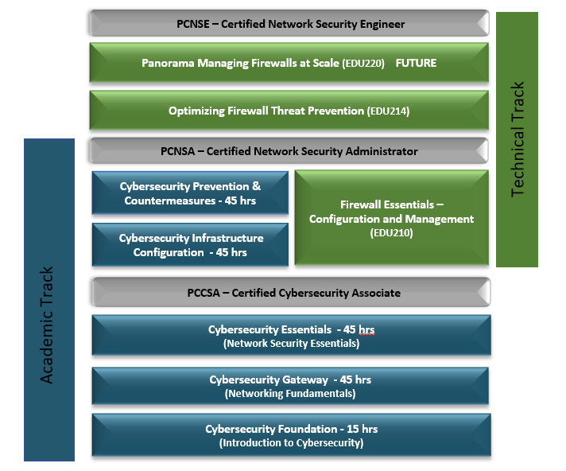
Palo Alto Networks Cybersecurity Academy Curriculum Tracks
Academic
Technical
Notes:
Cyber Security Foundation Course is currently available self-paced e-learning course. (1 Credit General Cybersecurity Concepts – (Entry Level - 15 Contact Hours)
Cyber Security Gateway Course is currently available. (3 Credit Fundamental Networking and Security – 100 Level - 45 Contact Hours)
Cyber Security Gateway Assessment is currently available on our LMS.
Cyber Security Essentials Course is currently available. (3 Credit Technical Cybersecurity Concepts – 100/200 Level – 45 Contact Hours)
Cyber Security Essentials Certification is currently available through PearsonVue.
Cyber Security Infrastructure Configuration course is currently available. (3 Credit – 200 Level – 45 Contact Hours)
Cyber Security Infrastructure Assessment will be available December 2017.
Cyber Security Defense & Countermeasures course will be available December 2017. (3 Credit – 200 Level – 45 Contact Hours)
Cyber Security Certified Technician Certification will be available June 2018.
Cyber Security Management Course will be available February 2018. (3 Credit Multiple Firewall Design, Configuration, and Deployment – 300 Level – 45 Contact Hours)
Cyber Security Fault Analysis Course will be available April 2018. (4 Credit Troubleshooting Firewall Configuration and Deployment – 400/500 Level – 60 Contact Hours)
Network Security Engineer Certification is currently available.

Slide 3






Step 1: Passing L3 Data Without Filtering Through Firewall
External Public DNS
Module 2: Initial Configuration
Management and Licensing
updates.paloaltonetworks.com
Licenses and signatures
Internal Laptop
192.168.10.100/24
Mgt Interface L3
Eth 1/2 Data: L3 Private
Eth 1/1 Data: L3 Public
Module 3: Interface Configuration
Zones, interface addressing, and routing
Any Public Web App
Trust Zone
Module 4: Security/Nat Policy
Firewall Rules and NAT
Untrust Zone

Slide 4
Step 2: Turn on firewall appliance features
Complete visibility of traffic
Know applications to allow
Custom Apps
Reduce attack surface area
Whitelist Applications
Creating Custom App-ID’s
Module 4: App-ID

Slide 5
Step 2 (continued): Turn on firewall appliance features
Protect against known attacks
Assign security profiles to firewall
security policies
Anti-virus profile
Vulnerability profile
Anti-spyware
File blocking
URL
Protect against Denial of Service
Zone protection profile
DoS Profile
Protect against unknown attacks
WildFire
Module 5: App-ID
Module 5: Content-ID
Module 6: URL Filtering

